Slide 1
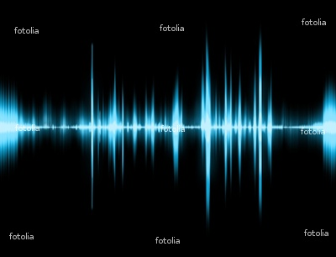
SOUND Energy

Slide 2
What is SOUND Energy?
Sound is a wave of vibrations
Sound travels through a material by bumping into other particles and making them vibrate
If there are no particles to vibrate, there is no sound!

Slide 3
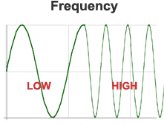
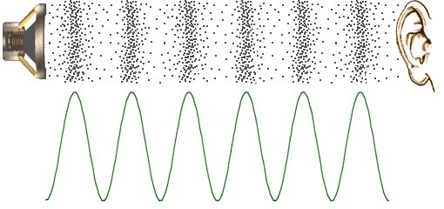
Waves
The number of cycles that pass by a point each second is the waves frequency
FREQUENCY – how fast particles are vibrating
The greater the frequency the higher the pitch
The lower the frequency the lower the pitch

Slide 4
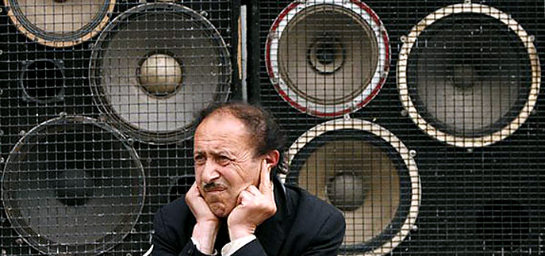
LOUD or SOFT
The more energy a sound wave has the louder it will be
A louder sound vibrates more than a softer sound
How loud or soft a sound is can be measured in units called DECIBELS

Slide 5
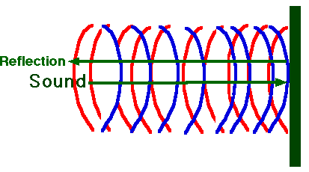
How does SOUND travel?
Sound can travel through solids liquids and gases
Sound can do three different things
Bounce back off an object (ECHO)
Be absorbed into a material or object
Pass through a material
← ECHO

