Slide 1
Sound Review

Slide 2
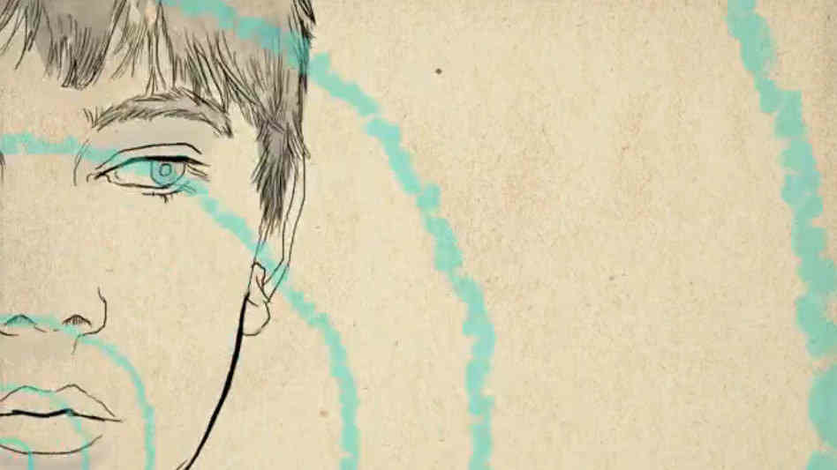
Sound
A type of energy that you can hear

Slide 3
Pitch
How high or low a sound is

Slide 4
Vibrations
A rapid back and forth movement

Slide 5
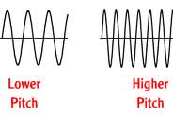
A faster vibration makes a higher pitch
A slower vibration makes a slower pitch

